Slide 1

Development of a secure application
Mentor: as. univ. M. Găidău
Students:
Ursu Vlad
Botezatu Marius
Bucătaru Daniel
Ciumac Alexei
Telug Anatolie
Fall 2023
Notes:
Vlad

Slide 2
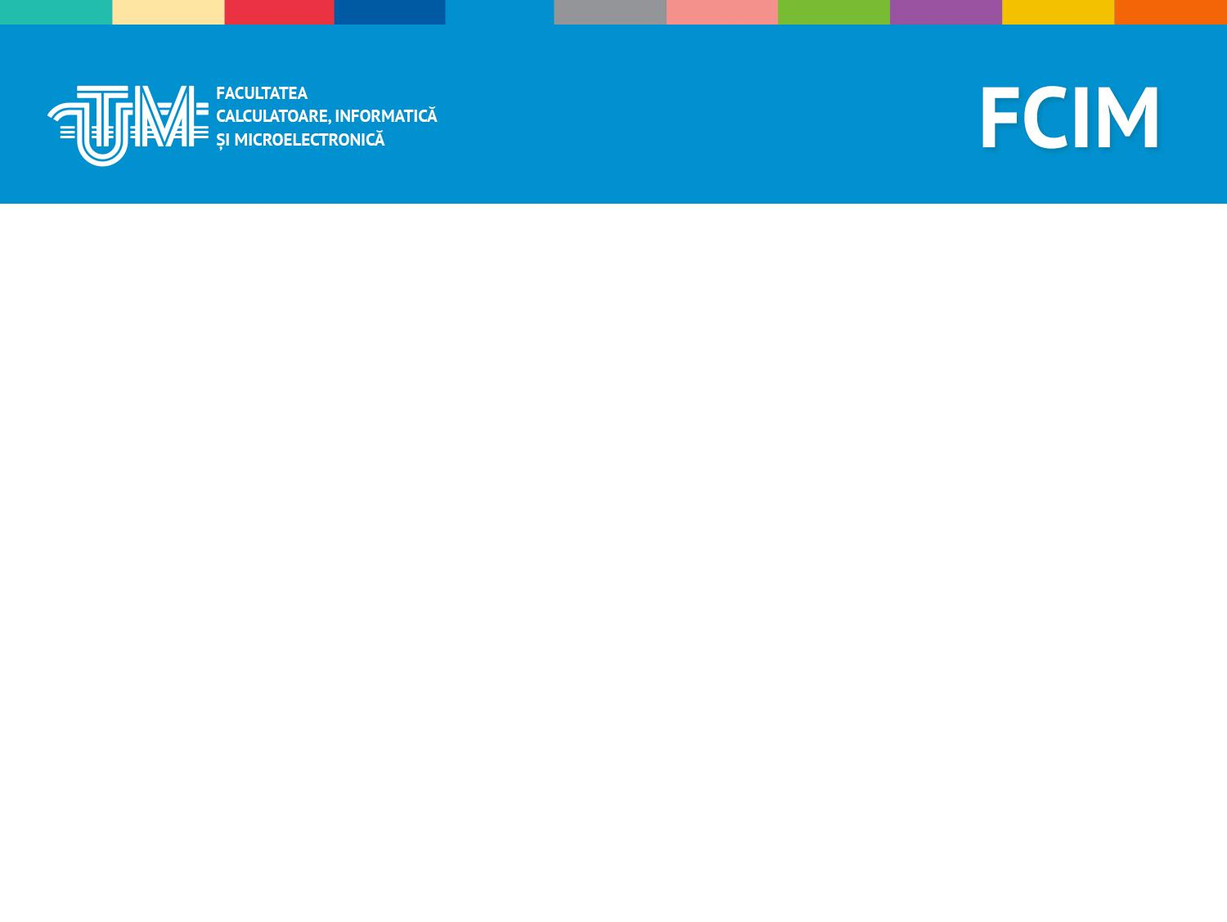
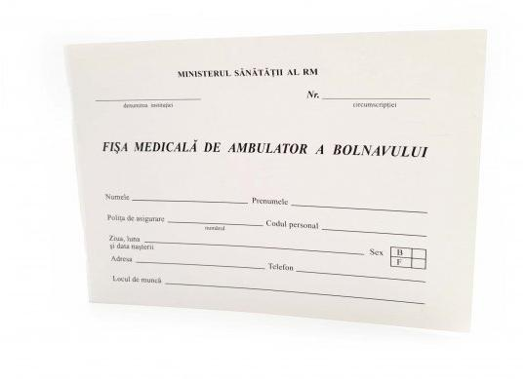
Identified problem
Inefficient data storage
Precarious physical storage
Availability and efficiency
Week 1
Notes:
Ira

Slide 3

Main Concept
Simple server-client app
Ready available to anyone
User-friendly UI
Secure operations, and data storage
Week 1
Notes:
Ira

Slide 4
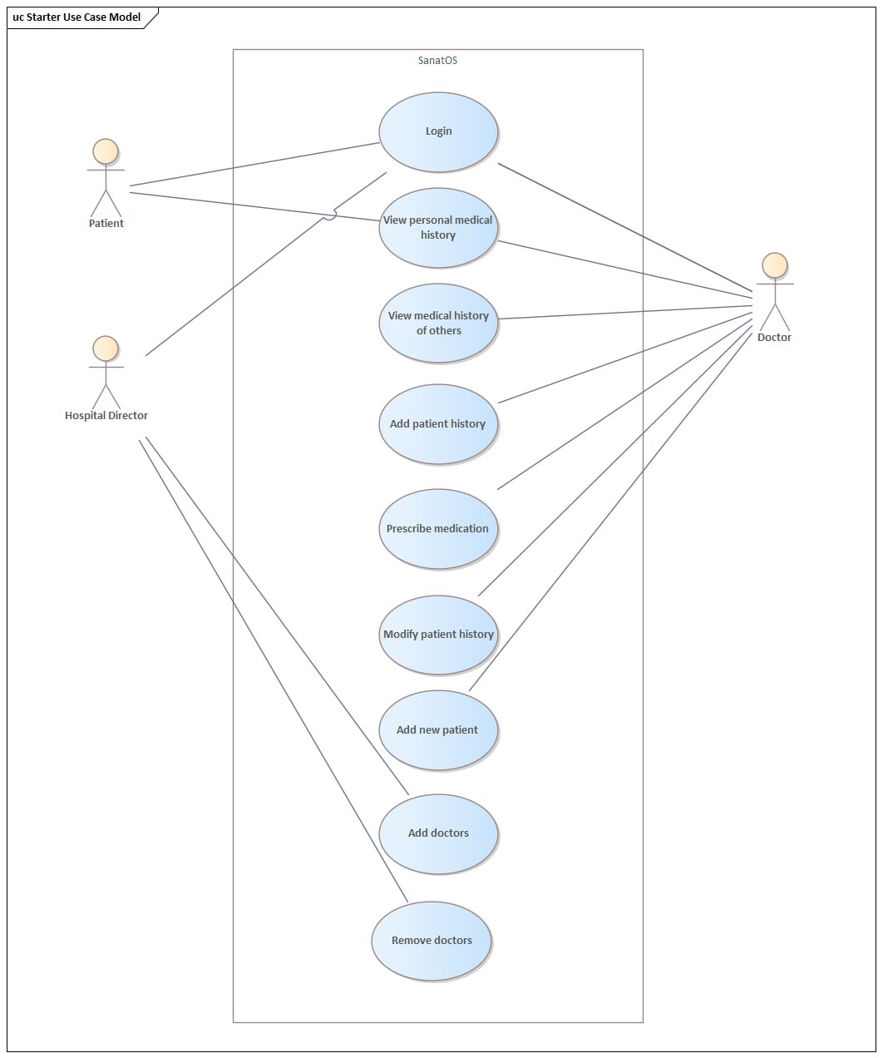
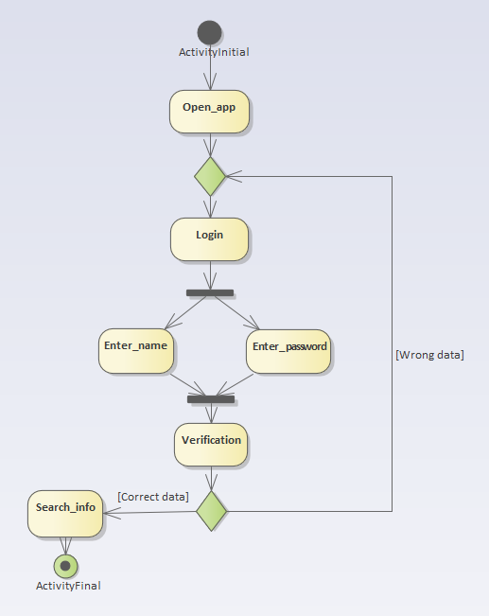
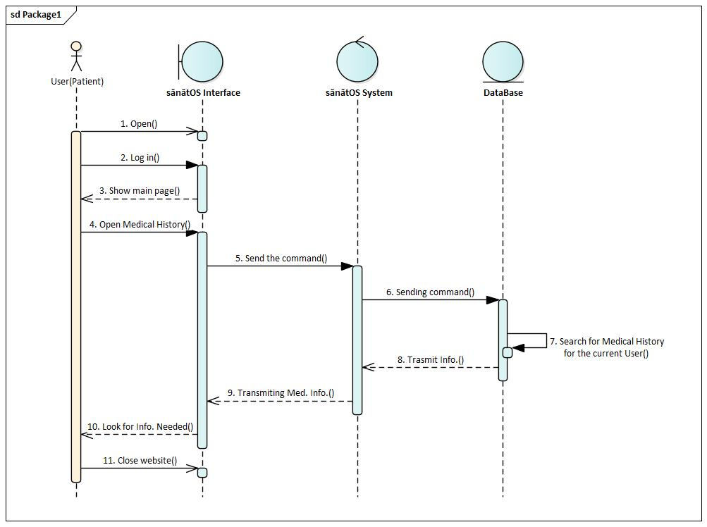
Creating the high-level structure
Week 1
Week 2
Notes:
Ira

Slide 5
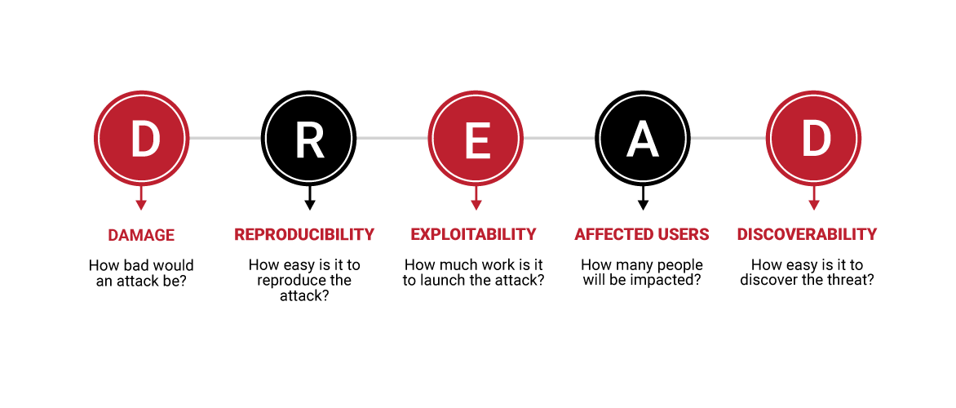
Security and safety (using DREAD)
8/10
6/10
6/10
9/10
8/10
Week 1
Week 2
Week 3
Notes:
Ira

Slide 6
Security and safety (overall score and solutions)
Solutions
Strong access controls and authentication
Encrypting sensitive data in the database
Regularly updating and patching the software
Conducting security testing
Providing training and awareness programs for developers, staff, and users
DREAD score: 7.4/10
Week 1
Week 2
Week 3
Notes:
Ira

Slide 7
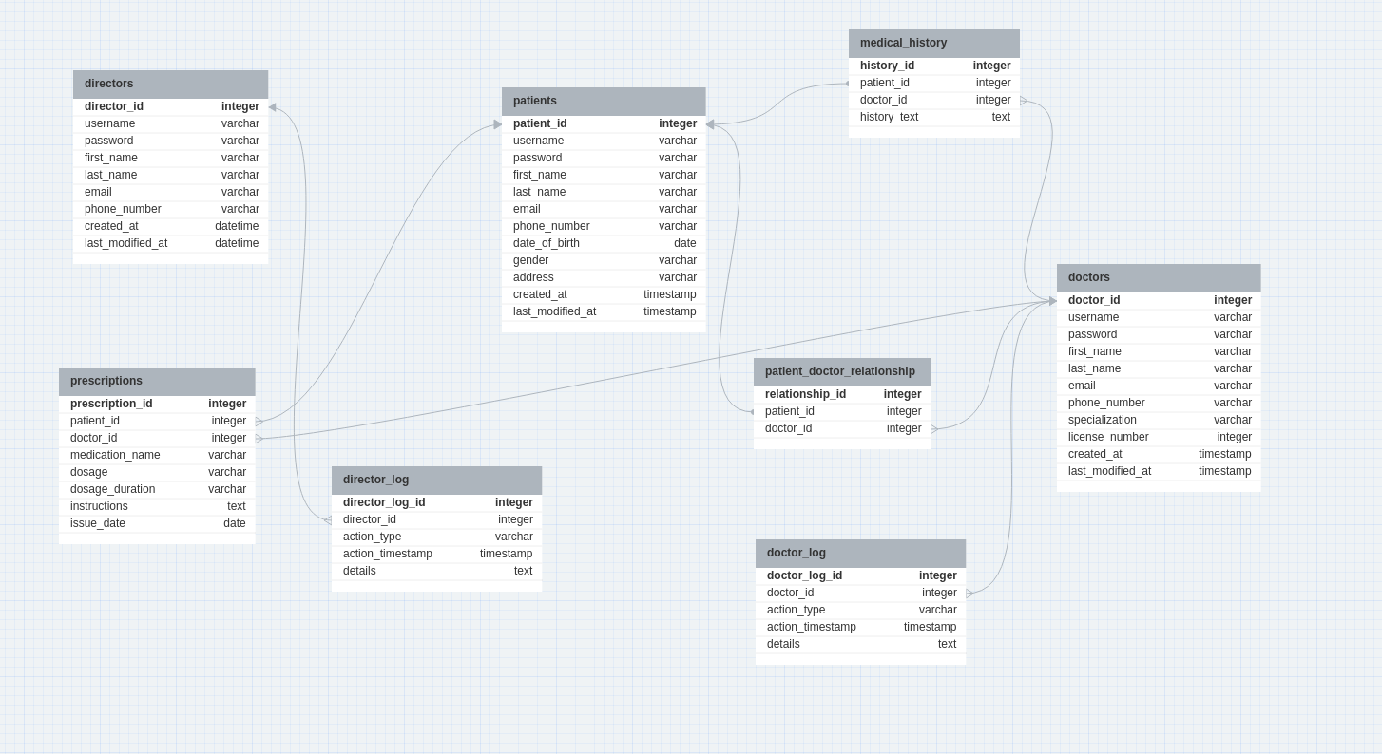
Creating the DB structure
Week 1
Week 2
Week 3
Week 4
Notes:
Ira

Slide 8
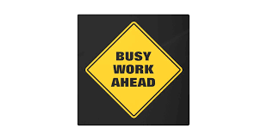
Future activities
Continued development on the front-end
Continued development on the back-end
Implementation of the identified security measures
Final goal: Deliver a working MVP or demo in time to the company mentors (or estimately in time for the second midterm)
Week 1
Week 2
Week 3
Week 4
Week 5
Week 6
Week 7
Week 8
Notes:
Ira

Slide 9
Thank you for your attention!
Notes:
Ira

